Slide 1
Anyone know what this is?
The CUB domain!
Notes:
CUB domains are 110-residue protein motifs exhibiting a β-sandwich fold and mediating protein–protein interactions in various extracellular proteins.
Garboriaud et al. 2011

Slide 2
Announcements
Quiz 8 will come out tonight or tomorrow, covering this week’s classes
It will be due Tuesday, November 8 (Election Day), at 11:59 pm.
http://www.sciencemag.org/news/2016/10/world-without-dna-and-black-holes-state-science-last-time-chicago-cubs-won-world-series

Slide 3
Genetic circuits, natural or synthetic, can perform logical operations
Computational System Biology, Sauro Lab, U-Washington

Slide 4
How would you construct:
A gene controlled by an AND circuit? (Coactivators)
A gene controlled by an OR circuit? (2 transcription factors acting on same promoter)
A gene controlled by a NAND circuit? (Corepressors)
A gene controlled by a NOR circuit? (Gene 3 is activated by the protein products of Gene 1 or Gene 2 or two TFs (OR circuit), then the protein product of Gene 3 inhibits Gene 4 (NOT).
A gene tuned to a small range of metabolite or transcription factor concentrations (not too low, not too high) (An activator and a repressor process with different thresholds that act on the same gene)

Slide 5
First: get lots of DNA or cDNA (from mRNA) Enzymatic Amplification of DNA by PCR
Polymerase chain reaction (PCR) is a technique to amplify specific DNA fragments.
It uses a very small amount of template.
Utilizes a heat-stable DNA polymerase (Taq polymerase) from bacteria living in hot springs.
Uses repeated cycles of denaturation, DNA replication, and cooling to double the amount of DNA during each cycle.
Uses an automated thermal cycler.
Kary Mullis won the Nobel Prize in 1993 for discovering this technique

Slide 6
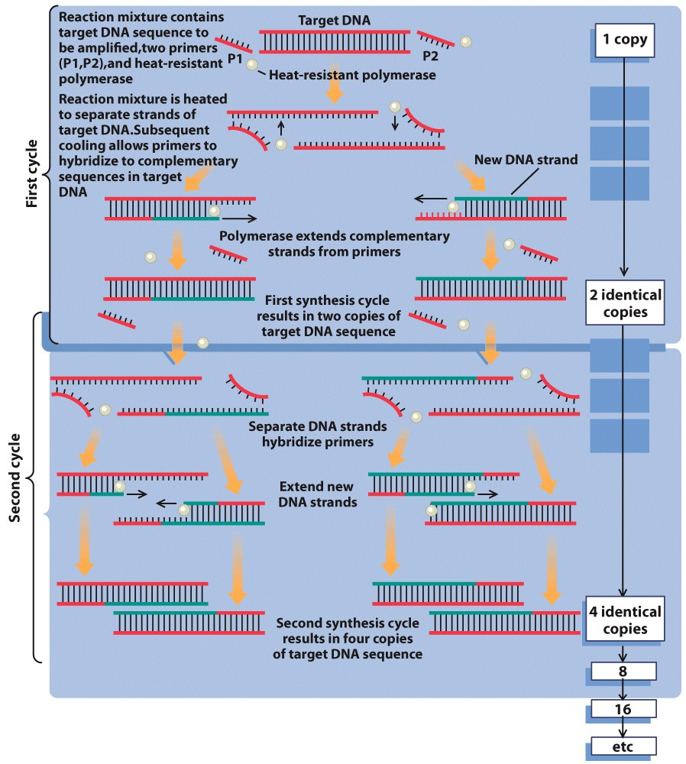
PCR

Slide 7
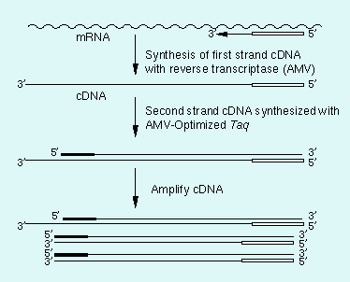
http://catalog.takara-bio.co.jp/en/product/basic_info.asp?unitid=U100005356

Slide 8
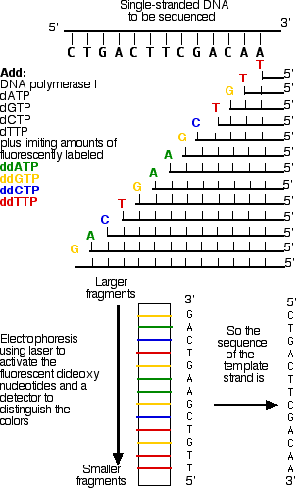
DNA Sequencing
This template DNA is supplied with a mixture of all four normal (deoxy) nucleotides in ample quantities
dATP
dGTP
dCTP
dTTP
a mixture of all four dideoxynucleotides, each present in limiting quantities and each labeled with a "tag" that fluoresces a different color:
ddATP
ddGTP
ddCTP
ddTTP
DNA polymerase I
Primer (DNA fragment complementary to 3’ end of DNA)
http://users.rcn.com/jkimball.ma.ultranet/BiologyPages/D/DNAsequencing.html

Slide 9
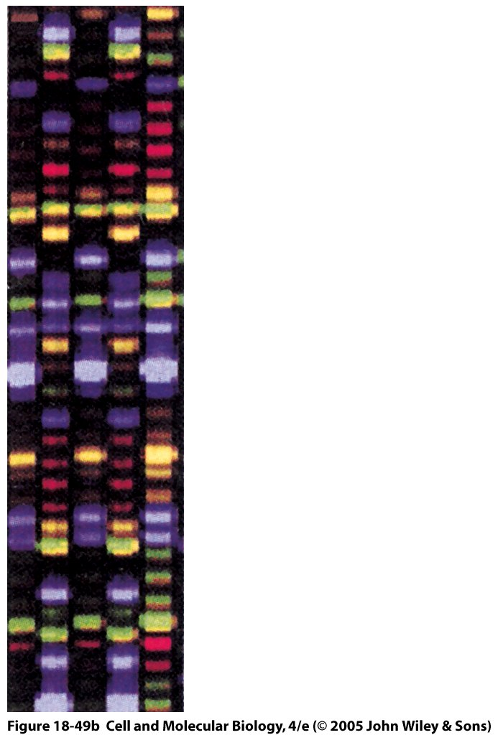
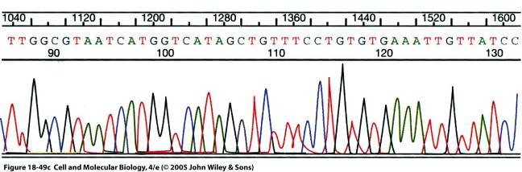
DNA Sequencing- Sanger-Coulson dideoxy method
DNA sequence can be interpreted by a scanner
- reads from bottom to top of the gel
can interpret the sequence according to the intensity and color of the detected fluorescence
Notes:
9

Slide 10
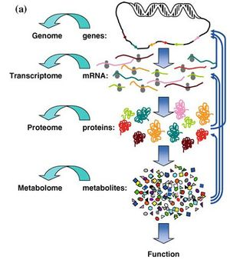
Omics
Transcriptomics
Proteomics
Metabolomics

Slide 11
Transcriptomics
DNA microarray
Can be used to monitor gene expression of thousands of genes expressed in a particular cell in a single experiment.
Working Principle: mRNA is complementary to the gene it was transcribed from, and this exact complementarity provides a means of chemically matching mRNA (present in sample) to its gene (attached to a gene chip), also called as hybridization. With appropriate dye labeling, this could be used to identify and quantify amount of mRNA present in the sample.
*mRNA is first converted to cDNA which is more stable than mRNA. Complementary DNA (cDNA) is synthesized from mRNA with the help of an enzyme reverse transcriptase and DNA polymerase.

Slide 12
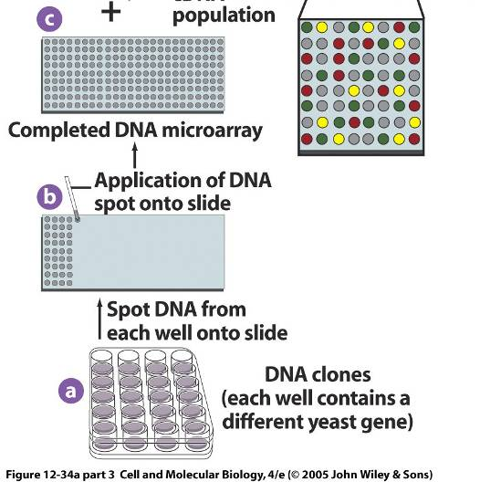
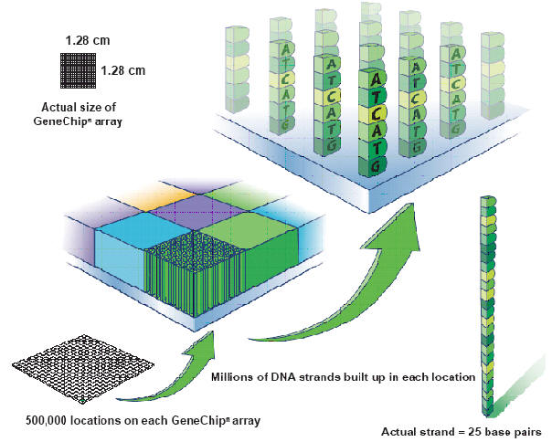
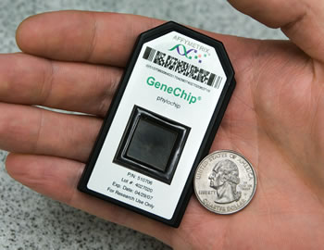
Construction of a gene-chip
A collection of microscopic DNA spots, commonly representing single genes, are arrayed on a solid surface by covalent attachment to a chemical matrix.
http://keck.med.yale.edu/affymetrix/genechip%20tile.jpg
Notes:
12

Slide 13


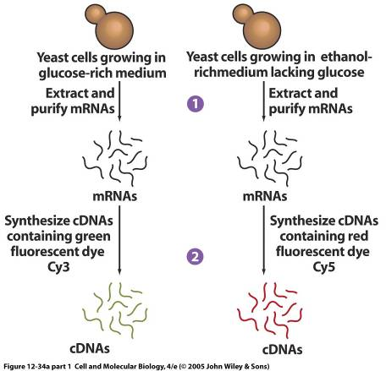
DNA Microarray experiment
Un-infected samples
Virus infected sample
Notes:
13

Slide 14
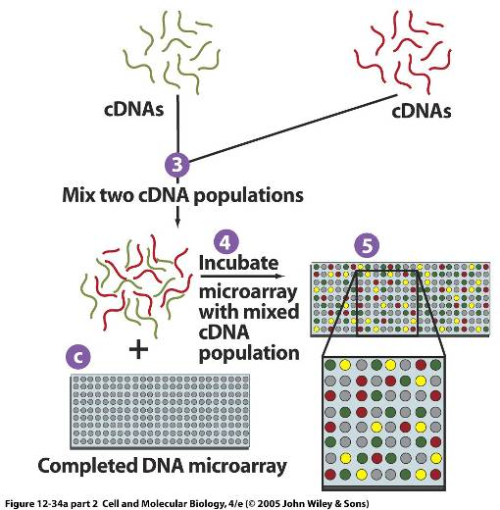
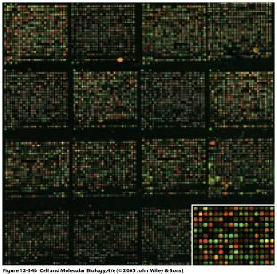
Dye labeled cDNA are added to the gene chip.
cDNA that hybridize (bind) to the chip DNA cause that spot to glow
Relative amount of red and green colors on a chip can be determined by a scanner.
Notes:
14

Slide 15
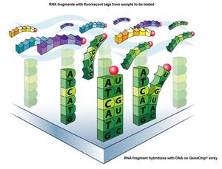
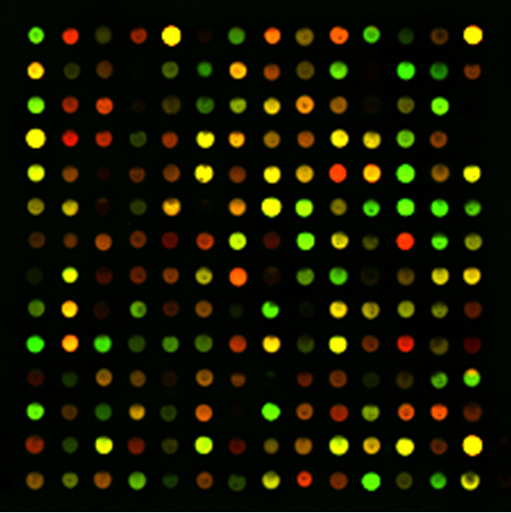
Interpretation of Microarray Experiment
All green spots: represent genes that are expressed in sample 1
All red spots: genes that are expressed in sample 2
All yellow spots: genes that are expressed in both the samples.
Black spots: ?
If a gene is not expressed in either sample -> Black spot
http://biomath.stanford.edu/oligo_bar_code_tag_sequences.html
Notes:
15

Slide 16
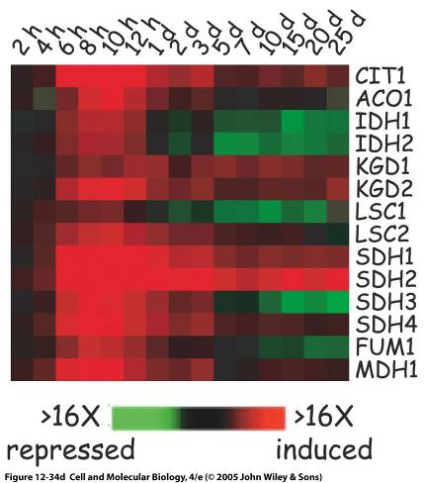
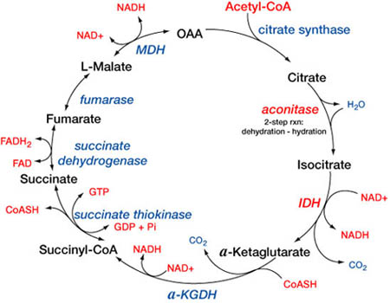
Example:
Which genes are expressed when in TCA cycle?
http://shop.builder.hu/pictures/SAN_tca_cycle.jpg
Notes:
16

Slide 17
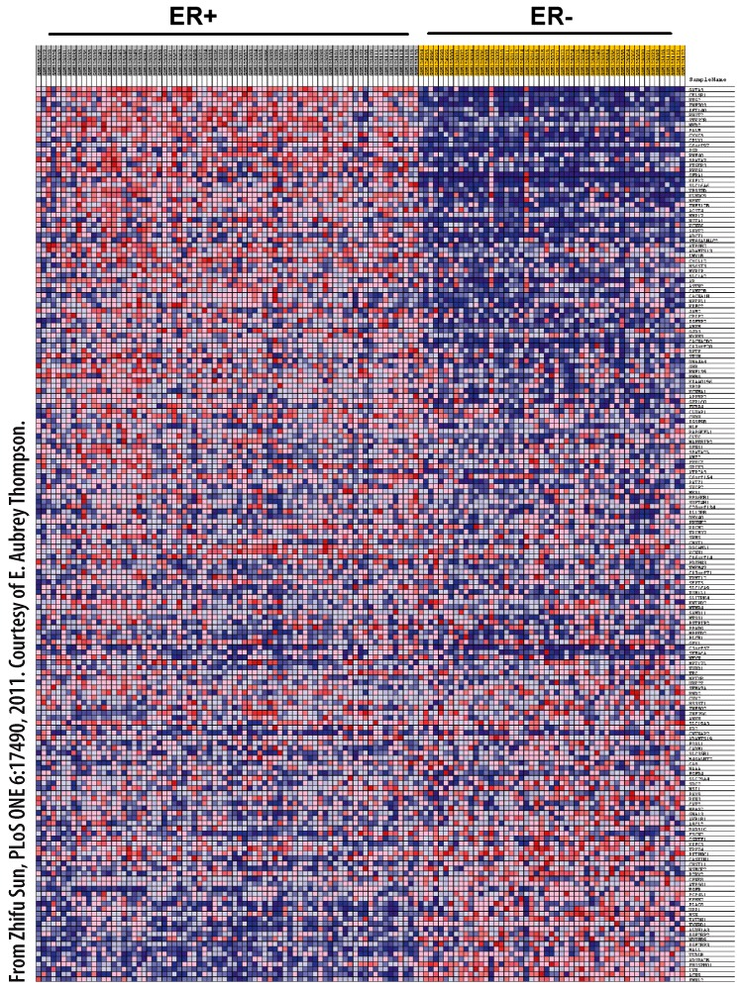
Transcriptional control
DNA microarrays
DNA microarrays can facilitate the diagnosis and treatment of human diseases.
Human breast tumors can be ER-positive or ER-negative.
These tumor subtypes show differences in a subset of genes.
Personalized medicine in the future will be reliant upon transcription profiling, not only for the diagnosis and to establish a treatment plan, but also to monitor the effectiveness of the treatment.
Transcription profiling to personalize breast cancer therapy. ER+ and ER- tumors show 179 genes that are differentially regulated. Expression ranges from low (blue) to high (red).
Notes:
Figure 12.36
Transcription profiling to personalize breast cancer therapy. Microarrays and RNA-sequencing technologies were used to examine gene expression patterns in 76 estrogen receptor positive and 53 estrogen receptor negative tumors. A total of 179 genes were identified that are differentially expressed between the two groups. The ability to define a molecular portrait of tumors that will respond to hormone therapy can personalize breast cancer treatment.

Slide 18
Using gene expression patterns to understand biological processes
AMP kinase, or AMPK, is a sensor for energy balance in the cell.
AMPK is activated by a rise in the AMP/ATP ratio (fall in ATP) and can control the transcription of multiple genes in order to restore the proper ratio.
Aging cells often have insufficient energy production, activating AMPK.
Given that, relative to the gene expression in young, how would you expect gene expression to change for the following enzymes:
Cytochrome oxidase (or a subunit of it)
Glucose transporter 4 (imports glucose into the cell)
Glycogen synthase (makes glycogen from glucose for energy storage rather than energy production)
ATP synthase (or a subunit of it)

Slide 19
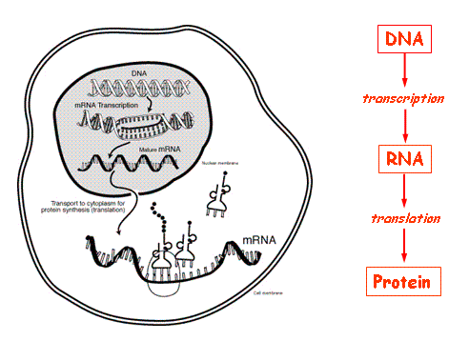
So now we know which genes from our array are being expressed in a given condition in a particular cell type i.e. which genes are being transcribed into mRNA.
Next Question: Do all of these mRNA get translated into proteins?
Does mRNA levels correlate with protein levels?
Yes! But..
Notes:
19

Slide 20
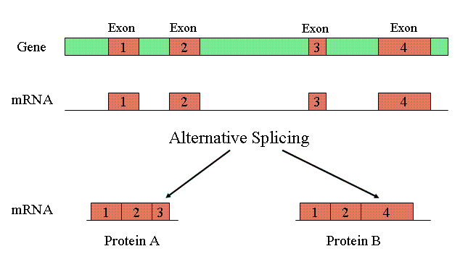
Gygi et al. (1999) Mol. Cell. Biol. compared protein levels and RNA levels for 156 genes in yeast
1. In some genes, mRNA levels were essentially unchanged, but protein
levels varied by up to 20X
Alternative Splicing:
Exons of a gene can be spliced together in different ways.
http://www.ncbi.nlm.nih.gov/Class/MLACourse/Modules/MolBioReview/alternative_splicing.html
2. In other genes, protein levels were essentially unchanged, but mRNA
levels varied by up to 30X
mRNA got degraded
Other translation machinery wasn’t present
Notes:
20
20

Slide 21
How to accurately identify the proteins being translated?
2D Gels
Mass Spectrometry
Western Blotting
Protein microarrays
Chromatography
Proteomics
Study of proteins, particularly their structure and function.
Notes:
21
21

Slide 22
Transcription-level control in eukaryotes
For bacteria, they can control transcription by having transcription factors such as repressor proteins interact directly with DNA
Transcription factors commonly control transcription in eukaryotes as well, but there is also another option…
Histones! Control of transcription by regulating histone-DNA interactions
Notes:
As an aside, the Histones sounds like a good name for a geeky musical group, and of course it is.
http://www.youtube.com/watch?v=N89tjP8DZr4

Slide 23
Teaching an old dogma new tricks: the histone code is a major addendum to the central dogma
Central dogma is DNA→ mRNA → protein
Gene → transcription → translation
The histone code hypothesis states that the activity of a chromatin region depends on the degree of chemical modification of histone tails.
Histone tail modifications influence chromatin in two ways:
Serve as docking sites to recruit nonhistone proteins.
Alter the way in which histones of neighboring nucleosomes interact with one another.
And tail modifications can be heritable, so that they can be passed on to a subsequent generation if in germ cells
Notes:
23

Slide 24
Histone control of access to DNA (eukaryotes only)
The histone code hypothesis states that the activity of a chromatin region depends on the degree of chemical modification of histone tails.
Histone tail modifications influence chromatin in two ways:
Serve as docking sites to recruit nonhistone proteins.
Alter the way in which histones of neighboring nucleosomes interact with one another.
Notes:
24

Slide 25
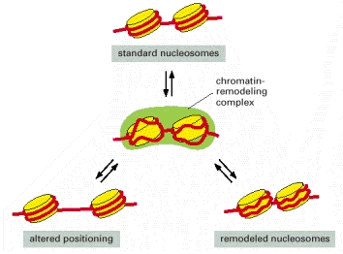
ATP-dependent chromatin remodeling permits access to DNA when needed (transcription!)
Alberts et al. Molecular Biology of the Cell
Notes:
Figure 4-33Model for the mechanism of some chromatin remodeling complexes
In the absence of remodeling complexes, the interconversion between the three nucleosomal states shown is very slow because of a high activation energy barrier. Using ATP hydrolysis, chromatin-remodeling complexes (green) create an activated intermediate (shown in the center of the figure) in which the histone-DNA contacts have been partly disrupted. This activated state can then decay to any one of the three nucleosomal configurations shown. In this way, the remodeling complexes greatly increase the rate of interconversion between different nucleosomal states. The remodeled state, in which the histone-DNA contacts have been loosened, has a higher free energy level than that of standard nucleosomes and will slowly revert to the standard nucleosome conformation, even in the absence of a remodeling complex. Cells have many different chromatin remodeling complexes, and they differ in their detailed biochemical properties; for example, not all can change the position of a nucleosome, but all use the energy of ATP hydrolysis to alter nucleosome structure. (Adapted from R.E. Kingston and G.J. Narlikar, Genes Dev. 13:2339–2352, 1999.)
From: Chromosomal DNA and Its Packaging in the Chromatin Fiber

Slide 26

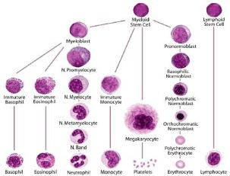
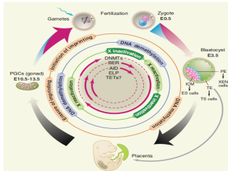
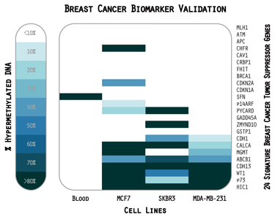
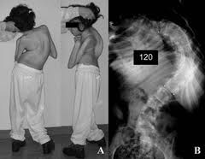
Epigenetics – a form of transcriptional level control via control of DNA genome
Epigenetics is the study of heritable changes in gene expression caused by mechanisms other than changes in the underlying DNA sequence
Histone modifications
DNA methylation
Ageing
Cellular differentiation
Embryonic Development
Cancer
Other diseases

Slide 27
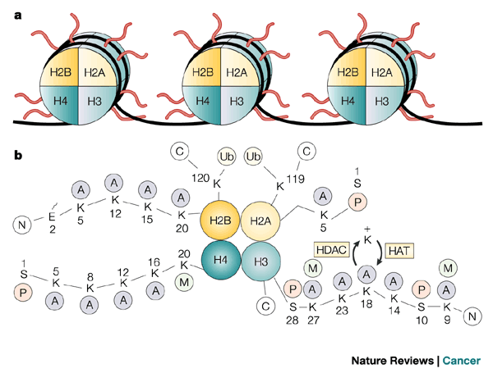
Histone review
DNA in eukaryotes often wraps around in a stereotyped fashion around these highly stereotyped protein subunits. The tails of the histone proteins may be modified to affect transcription and other signaling.

Slide 28
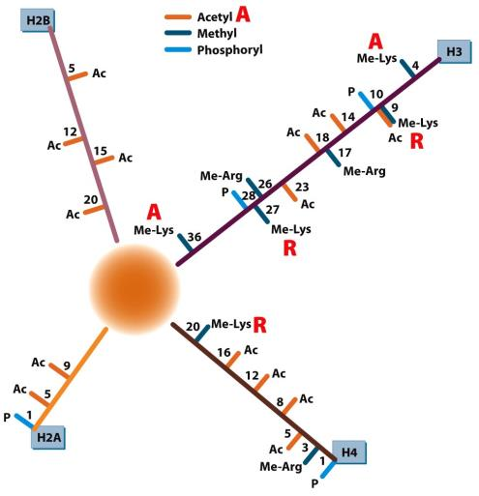
Histone modifications and “histone code”
Histone proteins can be phosphorylated, methylated or acetylated.
These modifications can make the DNA associated with the histone more or less accessible to transcription, depending on the specific pattern of modifications
Specific modifications can also recruit specific proteins that begin transcription of a gene (transcription factors)
The histone modifications form what is known as the “histone code”
Notes:
28

Slide 29
Histone modifications and “histone code”
Histone proteins can be phosphorylated, methylated or acetylated.
These modifications can make the DNA associated with the histone more or less accessible to transcription, depending on the specific pattern of modifications
Acetylated histones permit transcription, for example
Methylated histones typically block transcription
Histone phosphorylation has multiple functions
Notes:
29

Slide 30
Histone modifications are implicated in many diseases
Dysregulation can lead to many neurological diseases, as well as other diseases, especially in development.

Slide 31
Coactivators serve as intermediates for transcription factors, and are divided into two classes:
Those that interact with the transcription machinery (e.g. repressors).
Those that alter chromatin structure modifying histones to regulate transcription.
By using histone acetyltransferases (HATS)
By using chromatin remodeling complexes

Slide 32
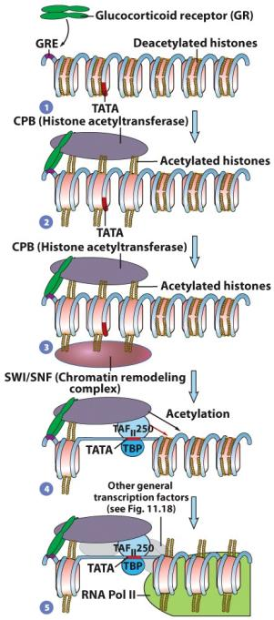
A model of events following the binding of a transcriptional activator
DNA around deacetylated histones is often inaccessible
Acetylation of histones by histone acetyltransferase permits transcription factor access and transcription to begin
Histones are then acetylated if needed downstream RNA polymerase

Slide 33
Transcriptional Repression
Histone deacetylases (HDACs) remove acetyl groups and repress transcription.
HDACs are subunits of larger complexes acting as corepressors.
Corepressors are recruited to specific gene loci by transcription factors that cause the targeted gene to be silenced.

Slide 34
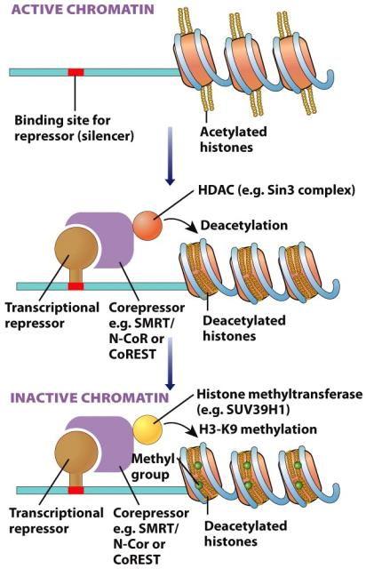
A model for transcriptional repression Histone deacetylases (HDACs) remove acetyl groups and repress transcription. HDACs are subunits of larger complexes acting as a corepressor (similar to trytophan operon, but for a eukaryote). Corepressors are recruited to specific gene loci by transcription factors that cause the targeted gene to be silenced. Histone methyltransferase methylates at specific sites to prevent transcription. Shown here are two stages of transcriptional inactivation: deacetylation followed by methylation

Slide 35
Clicker question – How might one distinguish transcription repression through histone modification versus by transcription factors?
Block all transcription in cell by removing RNA polymerase
Block histone acetylation and demethylation
Block histone methylation and deacetylation
Mutate the promoter region to render it non-functional
Notes:
The answer is C

Slide 36
Transcriptional Repression
DNA Methylation
It is carried out by DNA methyltransferases.
It silences transcription in eukaryotic cells.
Methylation patterns of gene regulatory regions change during cellular differentiation.
DNA methylation serves more to maintain a gene in an inactive state rather than to initially inactivate it.

Slide 37
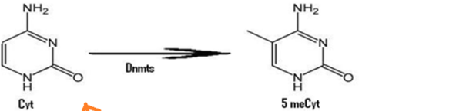
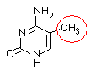
Cytosine methylation can suppress transcription and can be heritable across generations (epigenetics!)
Constitutes 1% of all DNA bases !
Found almost exclusively in the context of paired symmetrical methylation (methylation of both DNA strands of the dinucleotide CpG in repetitive DNA elements, or cytosine and guanosine linked by a phosphodiester bond, with GpC on the complementary strand.
Hypermethylation and hypomethylation of heterochromatin reported in cancers. Heterochromatin is tightly compacted DNA that may be inaccessible to transcription
Methylated cytosines typically block transcription or help to make heterochromatin.
Concentrations of CpG are often found near the 5’ end of genes, near the promoter region. These CpG islands are generally not methylated but can serve as gene markers in the genome.
Notes:
CpG islands (CGIs), which are, on average, > 200 bps show
an elevated G+C base composition,
little CpG depletion, and
frequent absence of DNA methylation.

Slide 38
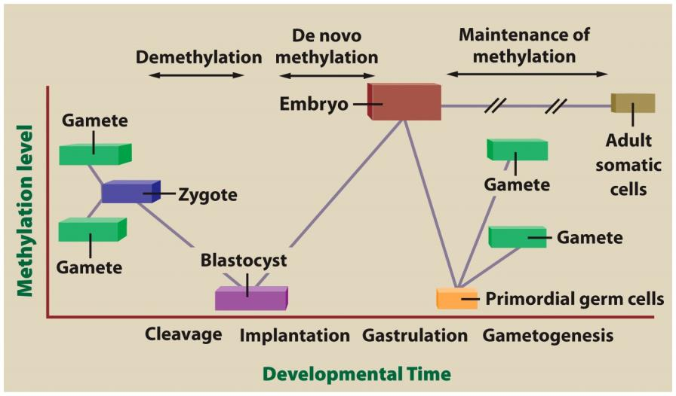
Changes in DNA methylation levels during mammalian development

Slide 39
Transcriptional Repression (continued)
Genomic Imprinting
Activity of certain genes, called imprinted genes, depends on whether they originated with the sperm or egg.
Active and inactive versions of imprinted genes differ in their methylation patterns.
Disturbances in imprinting patterns have been implicated in a number of rare human genetic disorders.

Slide 41
Found in translation: from mRNA to protein
In 2009, HSBC bank had to launch a $10 million rebranding campaign to repair the damage done when its catchphrase "Assume Nothing" was mistranslated as "Do Nothing" in various countries.

Slide 42
An EPIC Translation Movie
https://www.youtube.com/watch?v=WTRmvnlNVw4
Notes:
https://www.youtube.com/watch?v=WTRmvnlNVw4

Slide 43
Translation videos
http://www.youtube.com/watch?v=5bLEDd-PSTQ
http://www.youtube.com/watch?v=Ikq9AcBcohA

Slide 44
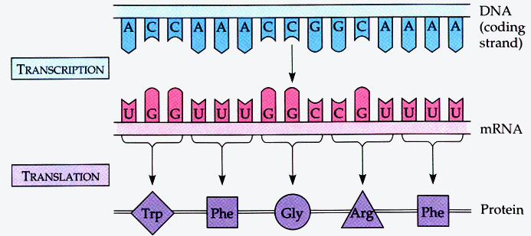
Another way to look at information flow…
What does this mean?
If we know the sequence of a gene (DNA) we can (basically) deduce the protein sequence if we know that the DNA sequence is an exon.
DNA -> RNA uses complementary base pairs
RNA -> protein is not complementary - translation needs a special intermediate (tRNA) and a protein-RNA complex called the ribosome
Notes:
Examples of translation from one form to another? Binary to Ascii or voltage, languages (obviously) but in that case the carrier of information (sound) has not changed forms. Sign language or reading to speaking may be better examples.

Slide 45
Going from nucleotide to peptide sequences
Recall, RNA polymerase II made mRNA (messenger RNA) using a strand of DNA as a template.
This RNA strand has a sequence of nucleotides whose bases are complementary to DNA sequence
In other words, there’s a 1 to 1 correspondence between DNA sequence and the primary RNA transcript
THIS IS NOT TRUE GOING FROM mRNA to POLYPEPTIDE!
Amino acids are encoded by ‘codons.’

Slide 46
Clicker Question
If a codon consists of 3 nucleic acids, how many possible different codons exist?
3
16
64
128
8675309
Notes:
Answer is C, 4x4x4

Slide 47
Codons: What a bunch of degenerates!
comprised of 3 consecutive nucleotides
written 5’ to 3’
4 nucleotides (U, C, A, G) so there are 4³ (or 64) codons
3 codons signal for “stop” (stopping translation)
So… there are 64 - 3 = 61 different codons for amino acids
Remember, there are 20 amino acids… so some amino acids must be encoded by more than one codon = the code is “degenerate”

Slide 48
Going from nucleotide to peptide sequences
Recall, RNA polymerase II made mRNA (messenger RNA) using a strand of DNA as a template.
This RNA strand has a sequence of nucleotides whose bases are complementary to DNA sequence
In other words, there’s a 1 to 1 correspondence between DNA sequence and the primary RNA transcript
THIS IS NOT TRUE GOING FROM mRNA to POLYPEPTIDE!
Amino acids are encoded by ‘codons.’

Slide 49
Getting it made.
For replication and transcription, the cell uses base pairing of complementary nucleotides… what about translation?
The problem: the structures of amino acids and nucleotides are not complementary.
The solution: tRNA serves as an intermediary.
one end - attached to a specific amino acid
other end - complementary to codon (“anticodon”)

Slide 50
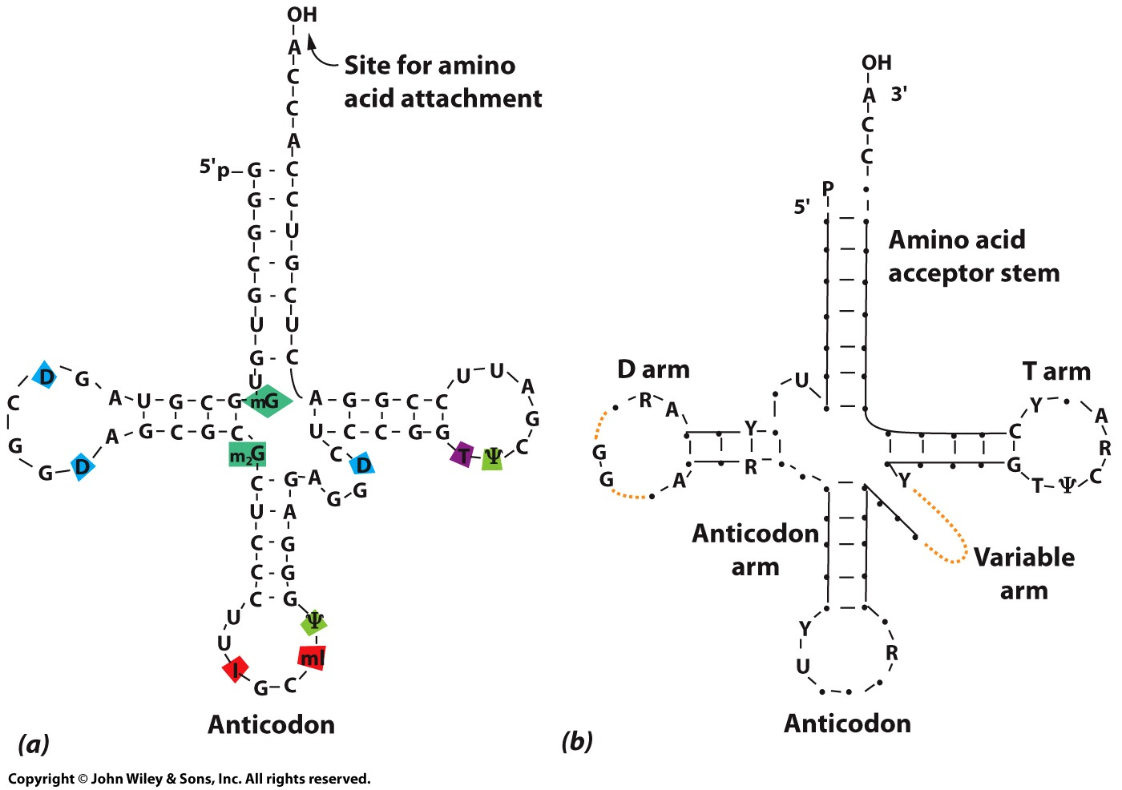
transfer RNA (tRNA)
Made by RNA polymerase III in eukaryotes and RNA polymerase in prokaryotes
70-90 nucleotides long
Contains
1. a conserved region (3’-ACC) where the amino acid is attached and
2. a unique region called the “anticodon triplet”
3. The blue and red are the T and D arms, which help with recognition by the ribosome
Notes:
Figure 11.42
The blue and red are the T and D arms, which help with ribosome recognition.

Slide 51
Clicker Question
What is the critical adapter component for translation, permitting a conversion from a nucleic acid to an amino acid code?
DNA
Pre-mRNA
Mature mRNA
tRNA
Chaperones
Notes:
Answer is D

Slide 52
Main points thus far…
ORFs begin at 1st AUG nearest 5’ end
Codons = 3 nts, encode aa’s
61 aa codons but only 20 aa’s
“Degenerate” code
Sequence of nts -> sequence of aa’s
tRNA provides link between aa’s and codons
tRNA charging via aminoacyl-tRNA-synthetase
1 anti-codon can recognize > 1 mRNA codon

Slide 53
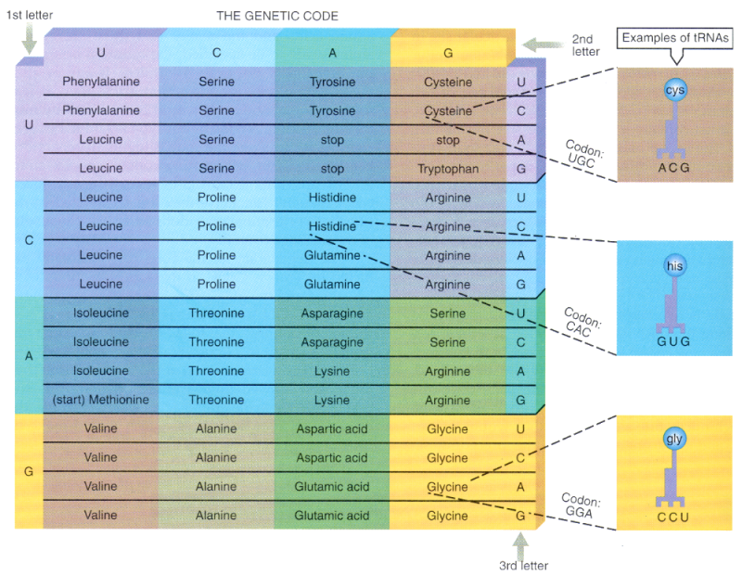
Universal decoder chart
See Figure 11.40 on page 463 of Karp.

Slide 54
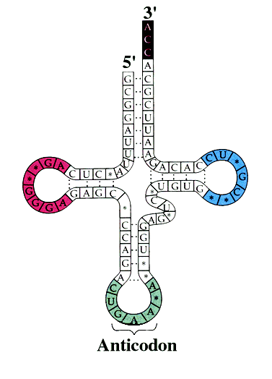
Getting the tRNA ready for translation
O
O
H
=
=
-O-P-O-C-C-NH₂
-
O
R
AA’s are added onto the free 3’ OH of tRNA
This process is called “charging”
D arm
T arm

Slide 55
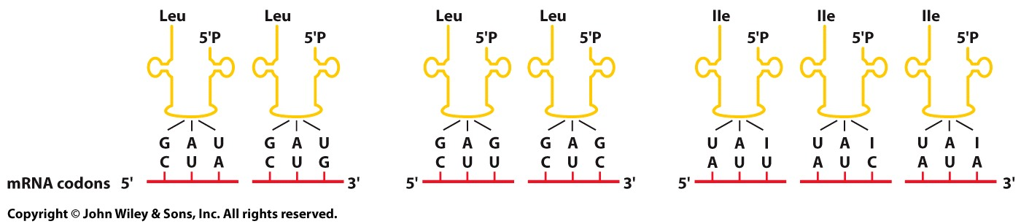
Decoding the Codons: The Role of tRNAs Wobble in the interaction between codon & anticodon
The wobble interaction: The nucleotide at the 5’ end of the tRNA anticodon is capable of pairing with more than one nucleotide at the 3’ end (third position) of the mRNA codon
The Structure of tRNAs
The wobble hypothesis suggests that a tRNA can recognize codons with variable third bases.
3rd position: U (AC) with A or G (codon); G (AC) with U or C (codon); I (AC) with U, C, or A (codon)
Notes:
Figure 11.44
The wobble in the interaction between codons and anticodons. In some cases, the nucleotide at the 5’ end of the tRNA anticodon is capable of pairing with more than one nucleotide at the 3’ end (third position) of the mRNA codon. Consequently, more than one codon can use the same tRNA. The rules for pairing in the wobble scheme are indicated in the figure as well as in the text.

Slide 56
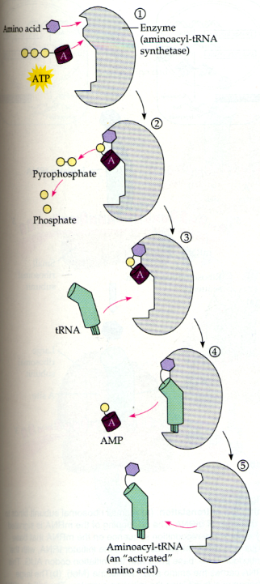
Viewing charging in another way
Catalyzed by aminoacyl-tRNA-synthetases (cytoplasmic)
ATP’s are used producing a phosphodiester linkage and an adenylated amino acid
tRNA displaces AMP and binds to amino acid
Charged tRNA is released
20 synthetases - 1 per amino acid
But there are several anticodons (tRNAs) per aa
So a synthetase can usually charge more than one type of tRNA
Notes:
The two-step process in which an amino acid (with its side chain denoted by R) is activated for protein synthesis by an aminoacyl-tRNA synthetase enzyme is shown. As indicated, the energy of ATP hydrolysis is used to attach each amino acid to its tRNA molecule in a high-energy linkage. The amino acid is first activated through the linkage of its carboxyl group directly to an AMP moiety, forming an adenylated amino acid; the linkage of the AMP, normally an unfavorable reaction, is driven by the hydrolysis of the ATP molecule that donates the AMP. Without leaving the synthetase enzyme, the AMP-linked carboxyl group on the amino acid is then transferred to a hydroxyl group on the sugar at the 3′ end of the tRNA molecule. This transfer joins the amino acid by an activated ester linkage to the tRNA and forms the final aminoacyl-tRNA molecule. The synthetase enzyme is not shown in this diagram.

Slide 57
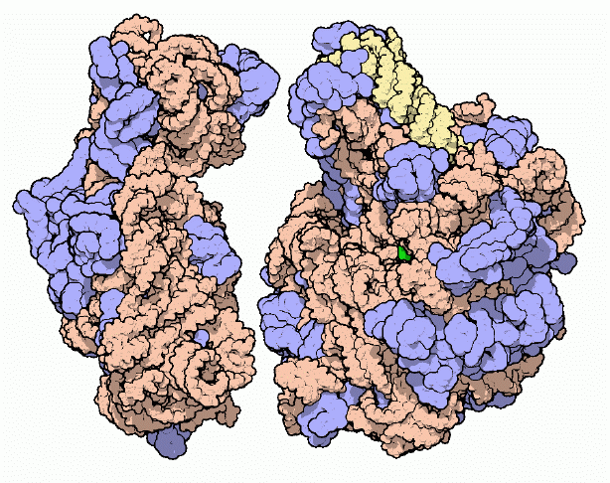
Cellular machine for protein synthesis: ribosome
50S subunit
30S subunit
Shown are the prokaryotic ribosome subunits
Composition:
two subunits: small & large
60% rRNA (initiation, alignment, peptide bond)
40% proteins
4.2 x 10⁶ Da
over 100,000 atoms
X-ray structure (a big deal when it was first done)
See http://www.rcsb.org/pdb/molecules/pdb10_1.html
Notes:
https://www.dnalc.org/resources/3d/16-translation-advanced.html
The units of a ribosome are often described by their Svedberg (s) values, which are based upon their rate of sedimentation in a centrifuge. The ribosomes in a eukaryotic cell generally have a Svedberg value of 80S and are comprised of 40s and 60s subunits. Prokaryotic cells, on the other hand, contain 70S ribosomes, each of which consists of a 30s and a 50s subunit. As demonstrated by these values, Svedberg units are not additive, so the values of the two subunits of a ribosome do not add up to the Svedberg value of the entire organelle. This is because the rate of sedimentation of a molecule depends upon its size and shape, rather than simply its molecular weight.

Slide 58
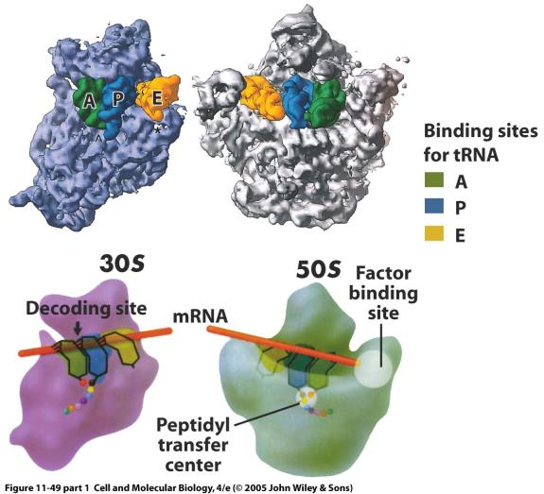
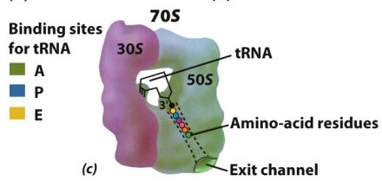
The 30S (small) and 50S (large) subunits come together to form three functional tRNA binding sites in bacteria: similar in eukaryotes
The active sites on the ribosome for tRNA are mostly RNA
Figure 11.48
Notes:
Figure 11.48

Slide 59
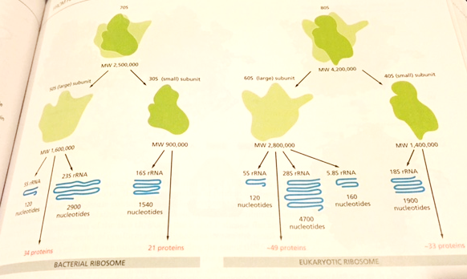
Bacterial vs. eukaryotic ribosome

Slide 60
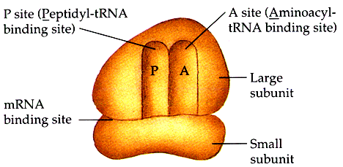
Simplified view of the ribosome
E
Notes:
The A-site (A for aminoacyl) of a ribosome is a binding site for charged t-RNA molecules during protein synthesis. One of three such binding sites, the A-site is the first location the t-RNA binds during the protein synthesis process, the other two sites being P-site (peptidyl) and E-site (exit).
In eukaryotes, synthesis of rRNA occurs with RNA polymerase I.

Slide 61
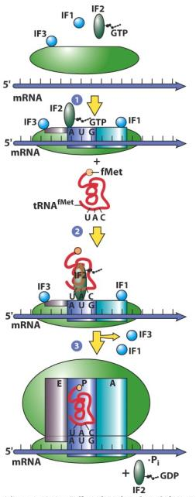
Summary of initiation (prokaryotes or eukaryotes)
Small ribosome subunit binds to mRNA bound in a complex
Initiation factors (IFs) bind to small subunit
One factor is bound with GTP
IF2-GTP in prokaryotes
eIF2-GTP in eukaryotes
rRNA recognizes AUG of mRNA 5’ → 3’
tRNA-Met binds IF2-GTP and small subunit
tRNA-Met enters P site
Initiation is the only time that the charged tRNA starts out in the P site
GTP hydrolyzed, large subunit binds, and IF2-GDP (or eIF2-GDP) released
Figure 11.47
Notes:
IF2-GTP is called eIF2-GTP in eukaryotes.

Slide 62
Elongation
next tRNA binds A site
Met
Ala
peptide bond forms
5’
5’
P site
A site
U A C
C G G
5’ - G C C A C C A U G G C C U G A - 3’

Slide 63
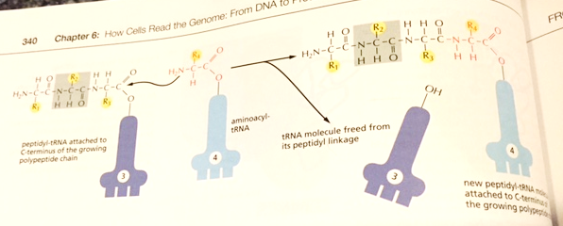
The amino group from the new amino acid forms a peptide bond with the carboxy terminus of the polypeptide chain

Slide 64
Clicker Question
What is the only charged tRNA that initiates in the P site of the ribosome?
f-Cys-tRNA
f-Met-tRNA
Gly-tRNA
All charged tRNAs may appear in the P site
Notes:
Answer is B. D is true after initiation has occurred

Slide 65
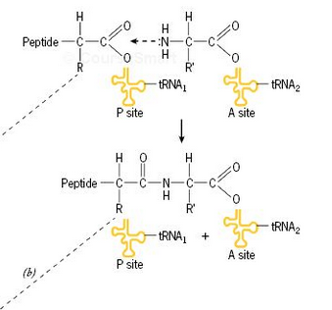
Details of elongation: peptide bond
amino group of aa-tRNA₂ binds carboxyl group of aa-tRNA₁
catalyzed by peptidyl transferase
large rRNA molecule of ribosome
peptidyl transferase then is an RNA catalyst, or ribozyme, rather than an enzyme, which is a protein catalyst.
tRNA₂ (in A site) has an attached dipeptide
tRNA₁ (in P site) has lost its amino acid
Figure 11.49b

Slide 66
Translocation
Met-
Ala
5’
5’
E site
P site
A site
U A C
C G G
5’ - G C C A C C A U G G C C U G A - 3’
GTP hydrolysis

Slide 67
Details of translocation
ribosome shifts 1 codon (1 nm) towards mRNA 3’ end
GTP hydrolyzed (EF involved)
codon 1 in E site
codon 2 in P site
codon 3 in A site
Met-
Ala
5’
5’
E site
P site
A site
tRNA exits at
E site
U A C
C G G
5’ - G C C A C C A U G G C C U G A - 3’

Slide 68
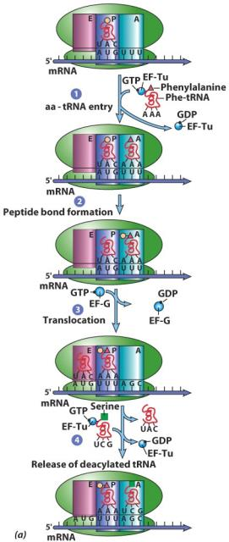
Summary of elongation
EF-GTP and aa-tRNA form a complex
aa-tRNA binds to codon in A site and has position adjusted using energy from GTP
Peptide bond forms with peptide in P site, peptide released from P site tRNA
Translocation of mRNA one codon, using GTP
Translocation of tRNA and peptide in large subunit. From P to E site and A to P site.
“Uncharged” tRNA in E site exits
New aa-tRNA enters A site to re-start cycle
Figure 11.49a

Slide 69
Termination
stop codon in A site
termination factors bind in A site to stop codon (proteins, GTP hydrolysis)
peptide cut from tRNA
ribosome dissociates
Met-Ala
5’
E site
P site
A site
STOP
C G G
5’ - G C C A C C A U G G C C U G A - 3’
Notes:
69
No tRNAs complementary to stop codons

Slide 70
Summary of translation
Small subunit binds mRNA
rRNA recognizes AUG on mRNA (start codon)
tRNA-Met enters P site and binds to AUG
Large subunit binds (GTP)
Second tRNA binds A site (GTP)
Peptide bond (peptide attached to 2nd tRNA)
Translocation by 1 codon towards 3’ end (GTP)
Release of 1st tRNA from E site
Continue steps 5-8 until stop codon is reached
Stop codon in A site -> termination (GTP)

Slide 71
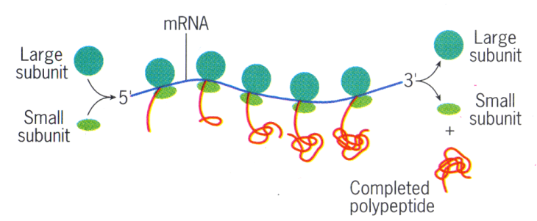
Simultaneous translation on polysomes
Protein synthesis starts at N-terminus = 5’ of ORF
mRNA translated 5’ to 3’ (peptide N- to C-term)
Ribosome covers ~40 aa’s of nascent polypeptide
As polypeptide emerges, it starts to fold
Rate of translation in eukaryotes is slow (2 aa/sec)

Slide 72
Generation of new cells requires significant amounts of protein synthesis, so one way to locally inhibit tumors, which are uncontrolled cell growths, is to inhibit protein synthesis. Addition of a compound, boilerizab, inhibits protein synthesis almost fully and may reduce or slow tumor growth. It is critical to identify the drug mechanism of action to determine whether this would be compatible for humans or would produce unwanted side effects.
How would you determine which part of protein synthesis boilerizab is affecting?
Write a hypothesis about identifying how protein synthesis is affected by boilerizab.
Design an experiment to test your hypothesis.
Draw two graphs, one to demonstrate the expected results of boilerizab on protein synthesis, and one to demonstrate the predicted results of your experiment.
Notes:
Give about 15 minutes.

Slide 73
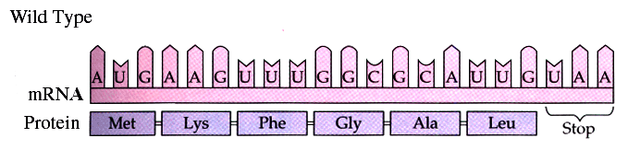
Mutations & their effects on protein synthesis
Base-pair substitutions, insertions, and deletions
frame-shift – many amino acids affected
non frame-shift – only one amino acid affected
missense – add start or stop

Slide 74
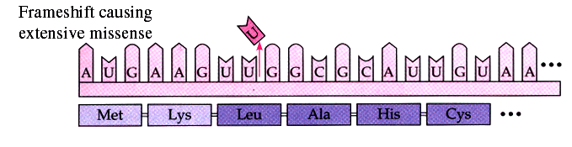
Frameshift with major effect

Slide 75
Clicker Question
Which mutation would have the greatest effect on an mRNA sequence of:
5’ - CGAUGAAGGCAUAAGC - 3’
5’ - CCAUGAAGGCAUAAGC - 3’
5’ - CGAUGAAGGUCAUAAGC - 3’
5’ - CGAUGAAGGCAUAAUC - 3’
5’ - CGAUGAAGGCCUAAGC - 3’
Notes:
Answer is B, an insertion to cause a frameshift.

Slide 76
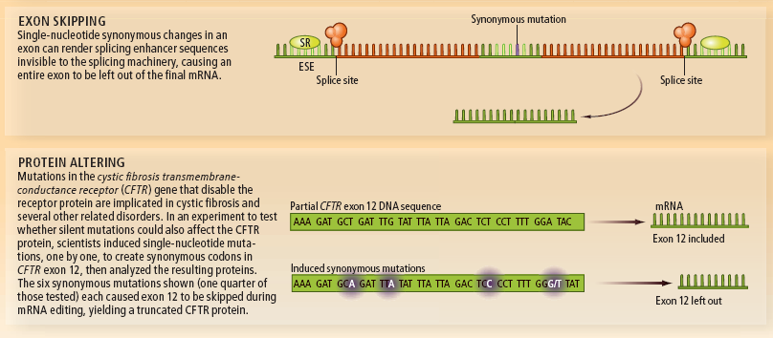
“Silent” mutations can actually have significant effects on protein expression and can result in diseases
A silent mutation occurs when the codon changes, but the amino acid does not
Chamary and Hurst, 2009, Scientific American

Slide 77

“Silent” (synonymous) mutations can be useful to control the rate of protein production
Different codons can have different translation efficiencies, which can be exploited by organisms or scientists
Chamary and Hurst, 2009, Scientific American

